Slide 1
UNIX Commands

Slide 2
Introduction
Operating systems are the building blocks of computer systems, and they provide the interface between user applications and computer hardware. Solaris is a multi-user, multitasking operating system developed and sold by Sun Microsystems.
Solaris is commonly found in large corporations and educational institutions that require concurrent, multi-user access on individual hosts and between hosts connected via the internet.

Slide 3
What is UNIX?
UNIX is an operating system which was first developed in the 1960s, and has been under constant development ever since. By operating system, we mean the suite of programs which make the computer work. It is a stable, multi-user, multi-tasking system for servers, desktops and laptops.

Slide 4
History of Unix
  Unix was born in 1969 in Bell Labs as a better way to run Space Travel, an astronomical-simulation program
  Ken Thompson, a Unix developer got frustrated with running Space Travel on Multics (Multiplexed information and computing system) computer.
  In 1973 after many revision in Assembly code, Ken Thompson and Dennis Ritchie rewrote Unix in C language just for that task.
  Eventually AT&T the owner of Bell Labs, released Unix to educational institution, but without any support.

Slide 5
Why Unix?
Unix has many advantages to offer:
  Openness, source code is publicly available
  Utilities, variety of commercial software available
  Portability, every kind of computer supports Unix
  Multiuser, Unix can handle many users running different programs
  Multitasking, A user can run different program simultaneously
  Networking, Unix allows computers to connect and share information, in fact Unix protocols forms the basis of the Internet
  Prevalence, Workstations that employ Unix help solve many complicated engineering and science problems

Slide 6
USES OF UNIX
User Support Tools
  Text processing (vi, sed, awk)
  Productivity applications
Programmer Support Tools
  Programming languages & compilers (C, C++, Java)
  Shell scripts
  Personal software process: version control
    Source Code Control System (SCCS)
    Revision Control System (RCS)
Unix as server
  Web server, mail server, application server
CSCI 330 - The UNIX System
Notes:
CSCI 330 - The UNIX System
NIU - Department of Computer Science

Slide 7
Types of UNIX
There are many different versions of UNIX, although they share common similarities.
The most popular varieties of UNIX are Sun Solaris, GNU/Linux, and MacOS X.

Slide 8
The Many Flavors of UNIX
The table summarizes some of the common UNIX variants and clones. While the table lists about forty different variants, the UNIX world isn't nearly as diverse as it used to be. Some of them are defunct and are listed for historical purposes. Others are on their way out. In some cases, vendors have defected to Microsoft technology. In others, mergers and acquisitions have led to the consolidation of different UNIX implementations. A list of "dead" UNIX implementations would be substantial indeed, consisting of hundreds of variations on the letters "U," "I," and "X" (CLIX, CX/UX, MV/UX, SINIX, VENIX, etc.).

Slide 9
UNIX Variant | Company/Org. | For More Info
A/UX | Apple Computer, Inc. | defunct
AIX | IBM | http://www.rs6000.ibm.com/
 |  | software/
AT&T System V | AT&T | defunct
BS2000/OSD-BC | Siemens AG | http://www.siemens.com/
 |  | servers/bs2osd/
BSD/OS | Berkeley Software Design, Inc. | http://www.bsdi.com
CLIX | Intergraph Corp. | http://www.intergraph.com
Debian GNU/Hurd | Software in the Public Interest, Inc. | http://www.gnu.org/
 |  | software/hurd/debian-
 |  | gnu-hurd.html
Debian GNU/Linux | Software in the Public Interest, Inc. | http://www.debian.org

Slide 10
DG/UX | Data General Corp. | http://www.dg.com/
 |  | products/html/dg_ux.html
Digital Unix | Compaq Computer Corporation | http://www.unix.digital.com/
DYNIX/ptx | Sequent Computer Systems, Inc. | http://www.sequent.com/
 |  | products/software/
 |  | operatingsys/dynix.html
Esix UNIX | Esix Systems | http://www.esix.com/
FreeBSD | FreeBSD group | http://www.freebsd.org
GNU Herd | GNU organization | http://www.gnu.org
HAL SPARC64/OS | HAL Computer Systems, Inc. | http://www.hal.com
HP-UX | Hewlett-Packard Company | http://www.hp.com/
 |  | unixwork/hpux/

Slide 11
Irix | Silicon Graphics, Inc. | http://www.sgi.com/
 |  | software/irix6.5/
Linux | several | http://www.linux.org
LynxOS | Lynx Real-Time Systems, Inc. | http://www.lynx.com/
 |  | products/lynxos.html
MachTen | Tenon Intersystems | http://www.tenon.com/
 |  | products/machten/
MacOS X Server | Apple Computer, Inc. | http://www.apple.com/macosx/
Minix | none | http://www.cs.vu.nl/~ast/
 |  | minix.html
MkLinux | Apple Computer, Inc. | http://www.mklinux.apple.com
NCR UNIX SVR4 MP-RAS | NCR Corporation | http://www3.ncr.com/
 |  | product/integrated/
 |  | software/p2.unix.html
NetBSD | NetBSD group | http://www.netbsd.org
NeXTSTEP | NeXT Computer Inc. | defunct, see http://www.apple.com/
 |  | enterprise/

Slide 12
NonStop-UX | Compaq Computer Corporation | http://www.tandem.com
OpenBSD | OpenBSD group | http://www.openbsd.org
OpenLinux | Caldera Systems, Inc. | http://www.calderasystems.com
Openstep | Apple Computer, Inc. | http://www.apple.com/
 |  | enterprise/
QNX Realtime OS | QNX Software Systems Ltd. | http://www.qnx.com/
 |  | products/os/qnxrtos.html
Red Hat Linux | Red Hat Software, Inc. | http://www.redhat.com/
Reliant UNIX | Siemens AG | http://www.siemens.com/
 |  | servers/rm/
Solaris | Sun Microsystems | http://www.sun.com/
 |  | software/solaris/
SunOS | Sun Microsystems | defunct
SuSE | S.u.S.E., Inc. | http://www.suse.com
UNICOS | Silicon Graphics, Inc. | http://www.sgi.com/software/
 |  | unicos/
UnixWare | SCO -- The Santa Cruz Operation Inc. | http://www.sco.com/unix/
UTS | Amdahl Corporation | http://www.amdahl.com/uts/

Slide 13
UNIX OS
The UNIX operating system is made up of three parts;
the kernel,
the shell and
the programs.

Slide 14
The Kernel
The kernel of UNIX is the hub of the operating system: it allocates time and memory to programs and handles the filestore and communications in response to system calls.
the shell and the kernel work together,.

Slide 15
The Shell
The shell acts as an interface between the user and the kernel. When a user logs in, the login program checks the username and password, and then starts another program called the shell. The shell is a command line interpreter (CLI). It interprets the commands the user types in and arranges for them to be carried out. The commands are themselves programs: when they terminate, the shell gives the user another prompt (% on our systems).

Slide 16
Three Major Functions of the Login Shell
The interface between you and the UNIX "kernel"
The "kernel" is the portion of UNIX that is always in the computer's memory. It interfaces directly with the machine's hardware:
A Command Interpreter
The shell interprets the commands that you type at the keyboard. It essentially "listens" to the commands that you enter from the keyboard. Once you type those commands and enter them, the shell interprets the commands and takes action based on what you've typed.
The shell looks for flags and arguments to UNIX commands, looks for shell metacharacters, and other special symbols.

Slide 17
A Programming Language
UNIX shells allow you to create simple (or very complex) "shell scripts" to make your life easier when you are performing highly repetitive tasks, or when you want to do some programming. These scripts contain a sequence of UNIX commands, very similar to the way you would use the commands if you typed them from the keyboard interactively.
UNIX shell scripts are similar to DOS "batch" files (.bat extension), but the operating system tools within UNIX are much greater in number and more powerful than those available in DOS.

Slide 18
Different Login Shell Types
There are three major login shells:
The Bourne shell (sh)
  The original UNIX shell
  Now viewed as "limited" in its capabilities as a login shell
The C shell (csh)
  Named after the C programming language
  Created at the University of California/Berkeley (UCB)
  Commonly used as a login shell
The Korn shell (ksh)
  From AT&T
  Supports all Bourne shell commands
  Supports many C shell commands
  Adds new features

Slide 19
The structure of Unix
user program
user program
user level
libraries
system/kernel
system call interface
system call interface
level
process control
file system
process control
file system
file system
inter
process
-
inter
-
-
process
communication
communication
buffer
scheduling
buffer
buffer
scheduling
cache
cache
cache
memory
memory
management
char
management
char
block
block
device drivers
device drivers
hardware control
hardware control

Slide 20
Standard Input, Standard Output & Standard Error
Input
comes in here
Standard Input
UNIX Command
Output sent out here
Standard output
Error messages
sent out here
Notes:
Standard Input, Standard Output & Standard Error

Slide 21
Process
A process is a program in execution.
The components of a process are:
  The program to be executed,
  The data on which the program will execute,
  The resources required by the program—such as memory and file(s)
  The status of the execution.

Slide 22
Process Identification Number
Each process has a unique identification
  PID (Process Identification Number)
PID
  is used to control the execution of a process
  used to index into proctab

Slide 23
proctab
proctab is the process table
an array of structures, one for each process currently active in the system

Slide 24
Files
Path name – relative, absolute
Current working directory
.- Current directory
.. Parent of the current directory
File descriptor (a handle)
Special files – abstraction of an 1/0 device
Block, character special files
Standard input, standard output, standard error
Inode, inode table

Slide 25
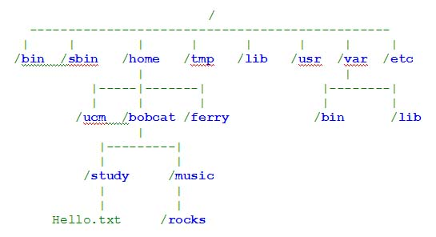

Slide 26
Directory | Description
[/] Root | It is the topmost directory which contains all OS directory structure. It is root user’s default home directory.
/export | It contains the file system which is to be exported to the n/w user while using the services such as NFS, NIS, Samba.
/export/home | It contains Solaris user’s home directory.
/lib | It contains all the library function for storage of module as well as holds kernel information.
/dev | It contains logical naming convention for specific devices. These files control various i/o devices such as HDD, printer etc.
/devices | It contains physical device naming convention.
/usr | It contains system configuration information and commands.

Slide 27
Directory | Description
/usr/bin | It contains binary executables which can be used to perform specific task performed by super user as well as regular user.
/usr/sbin | It contains binary executables to perform administrative task which can be only executed by super user.
/tmp | It contains temporary files. It is the default directory suggested to store internet downloaded data.
/etc | It contains all the system and service configuration files such as /etc/passwd, /etc/shadow, /etc/inittab, /etc/vfstab, /etc/dfstab etc.
/var | It is called as variable or varying directory and it holds system logs.
/mnt | It is the mount point to access different file systems.
/opt | It is optional directory in which we can store third party applications.
/proc | It contains process details of the currently running process on the system.

Slide 28
pwd Command
pwd (print working directory)
Pathnames enable you to work out where you are in relation to the whole file-system. For example, to find out the absolute pathname of your home-directory, type cd to get back to your home-directory and then type
$ pwd

Slide 29
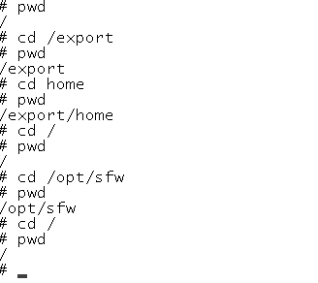
# pwd – It shows the present working directory

Slide 30
mkdir Command
mkdir (make directory)
This command will make a subdirectory in the current directory or to the specified directory to hold the files.
To make a subdirectory called sample in the current working directory type
$ mkdir sample
To see the directory that have just created, type
$ ls

Slide 31
cd Command
cd (Change Directory)
This command changes the current working directory to 'directory'. The current working directory may be thought of as the directory you are in, i.e. your current position in the file-system tree.
To change to the directory you have just made, type
$cd sample
Type ls to see the contents (which should be empty)

Slide 32
The current directory (.)
In UNIX, (.) means the current directory, so typing
$ cd .
NOTE: there is a space between cd and the dot
means stay where you are (the sample directory).
This may not seem very useful at first, but using (.) as the name of the current directory will save a lot of typing

Slide 33
(..) means the parent of the current directory, so typing
% cd ..
will take you one directory up the hierarchy (back to your home directory). Try it now.
Note: typing cd with no argument always returns you to your home directory. This is very useful if you are lost in the file system.

Slide 34
~ (your home directory)
Home directories can also be referred to by the tilde ~ character. It can be used to specify paths starting at your home directory. So typing
$ls ~/sample
This will list the contents of your sample directory, no matter where you currently are in the file system.

Slide 35
ls Command
The names of files and subdirectories can be displayed with the ls (list) command.
Options:
-F Marks directories with a trailing slash and executable files with a trailing asterisk.
-a Lists all the files including ., .. files
-l Lists in long format. Gives all sorts of information.
-R Recursively lists subdirectories encountered.
-s Gives the size of each file.
-t Sorts by time modified instead of by name.
-i Displays files with the inode number.

Slide 36
Unix File permissions
$ ls –l s1.txt
- rw-r--r-- 1 inatrn43 trg 32 Jun 2 11:50 s1.txt
rw-r--r--
r = readable
w = writable
x = executable
- = denied
Owner Group Other

Slide 37
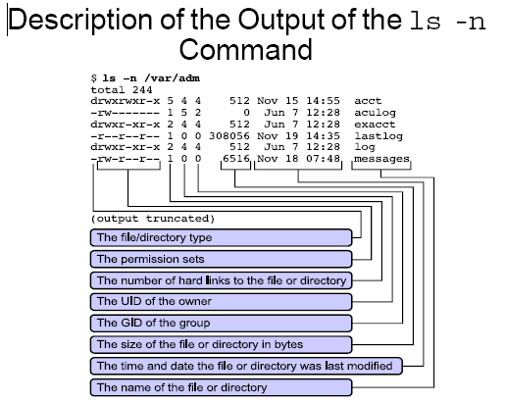

Slide 38
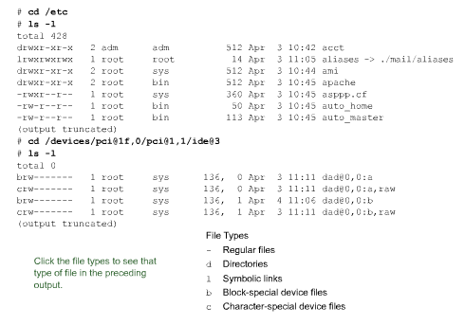

Unix file types

Slide 39
chmod command
chmod command is used to change permissions add(+) or remove(-) on a file.
ls -l displays the attributes of each file and directory in the working directory as given below
- rw-r--r-- 1 inatrn43 trg 32 Jun 2 11:50 s1.txt

Slide 40
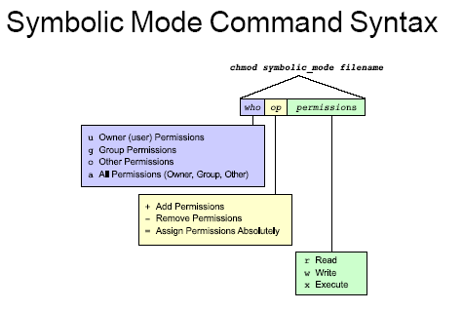

Slide 41
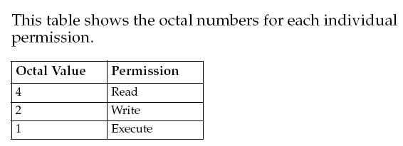

Slide 42
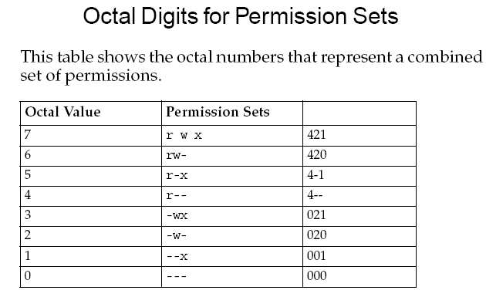

Slide 43
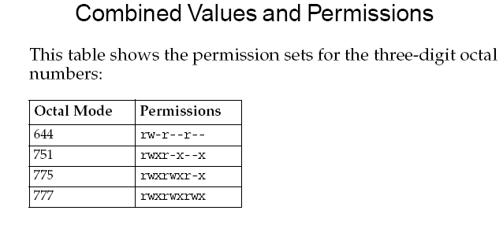

Slide 44
cat command
Catenate means "to connect in a series."
The cat command displays the contents of a file. If more than one file is placed in the command line, the contents of the files are displayed in succession.
With the use of the redirection operator, two files can be placed into a single file.
Example
cat sample.txt program.txt > merge.txt
It will cause merge.txt to contain the contents of sample.txt followed by the contents of program.txt.

Slide 45
umask (user mask)
umask command is used to set system-wide default permission for all new files created by a specific user.
If a user wants to use a umask other than the default system-wide setting, then the umask value can be changed in user’s shell startup file.
Like file permissions, the umask is set using octal codes.

Slide 46
There are two different strategies for computing
umasks.
For directories, subtract the octal value of the default permission, you want to set from octal 777
For files, subtract the octal value of the default permission you want to set from octal 666.

Slide 47
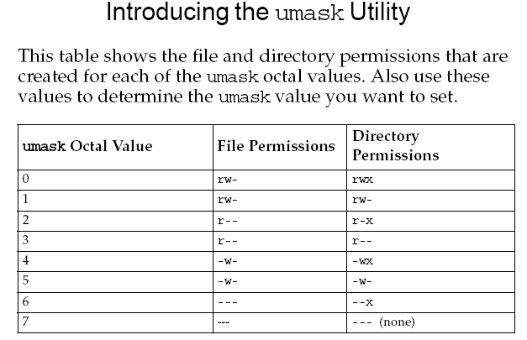

Slide 48
If you use the -n command line option with cat, your output will contain line numbers:
While a line is a line, even if it's empty, you could in some rare cases be only interested in numbering the lines which contain some information, and ignore the empty lines altogether. That's when a -b option comes handy:

Slide 49
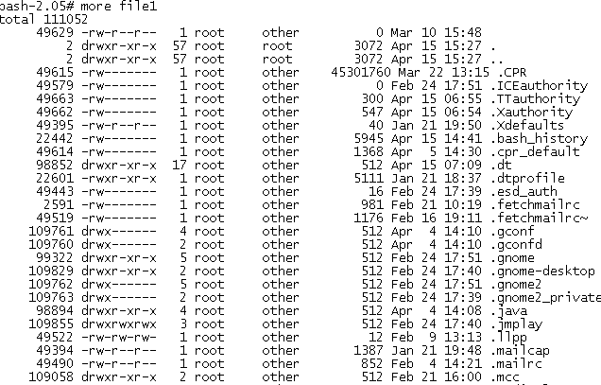
“ more “ command displays the file contents page wise.

Slide 50
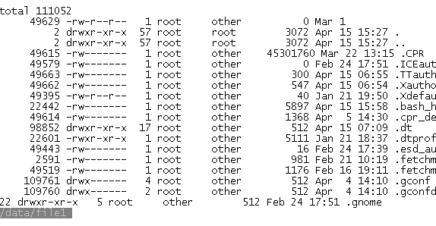
“ less “ command displays the file content like “ more “
command but, it has to be closed with “ q “.

Slide 51
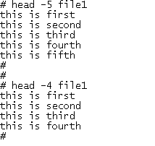
“ head “ command displays the file contents with “ – “option

Slide 52
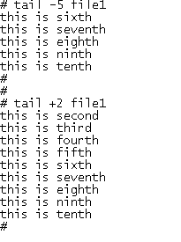
“ tail “ command displays file contents like “ head “
with “ - , + “ option.

Slide 53
mv command
mv command is used to move a file from one directory to another directory or to rename a file.
Some examples:
mv oldfile newfile will rename oldfile to newfile.
mv -i oldfile newfile for confirmation prompt.
mv -f oldfile newfile will force the rename even if target file exists.
mv * /usr/bajwa/ will move all the files in current directory to /usr/bajwa directory.

Slide 54
mvdir command
mvdir command is used to move a directory
The syntax is
mvdir <Source Directory> <Destination Directory>
Example
mvdir sam sample/

Slide 55
rm Command
rm command.
To delete files use rm command.
Options:
rm oldfile will delete file named oldfile.
rm -f option will remove write-protected files without prompting.
rm -r option will delete the entire directory as well as all the subdirectories, very dangerous command.
rm -i filename for confirmation prompt.

Slide 56
rmdir Command
rmdir command.
rmdir command will remove directory or directories if a directory is empty.
Options:
rm -r directory_name will remove all files even if directory is not empty.
rmdir sandeep is how you use it to remove sandeep directory.
rmdir -p will remove directories and any parent directories that are empty.
rmdir -s will suppress standard error messages caused by -p

Slide 57
wc Command
wc command
wc command counts the characters, words or lines in a file depending upon the option.
Options
wc -l filename will print total number of lines in a file.
wc -w filename will print total number of words in a file.
wc -c filename will print total number of characters in a file.

Slide 58
“ grep “ is the command which displays the line with the
matching pattern. It can be executed with more options.
Option | Definition
- i | Searches for both uppercase and lowercase characters
- l | Lists the names of files with matching lines
- n | Precedes each line with the relative line number in the file
- v | Inverts the search to display lines that do not match the pattern
- c | Counts the lines that contain the pattern
- w | Searches for the expression as a complete word, ignoring those matches that are substrings of larger words.

Slide 59
The “ grep “ command supports several regular expression
Meta characters to further define a search pattern. This table describes some of the regular expression meta characters. Regular expression meta characters:
Metacharacter | Purpose | Example | Result
^ | Beginning of line anchor | ’^pattern’ | Matches all lines beginning with “pattern”
$ | End of line anchor | ’pattern$’ | Matches all lines ending with “pattern”

Slide 60
Additional regular expression meta characters:
Metacharacter | Purpose | Example | Result
. | Matches one character | ’p.....n’ | Matches lines containing a “p,” followed by Five characters, and followed by an “n”
* | Matches the preceding item zero or more times | ’[a-z]*’ | Matches Lowercase Alphanumeric characters or nothing at all

Slide 61
“ grep “ continues …
Metacharacter | Purpose | Example | Result
[ ] | Matches one character in the pattern | ’[Pp]attern’ | Matches lines Containing “Pattern” or “pattern”
[^] | Matches one character not in the pattern | ’[^am] attern’ | Matches lines that do not contain “a” through “m” and followed by“attern”

Slide 62
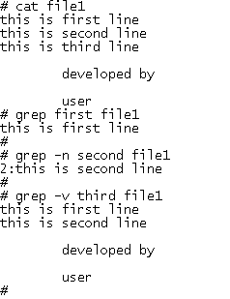
“ grep “ continues …

Slide 63
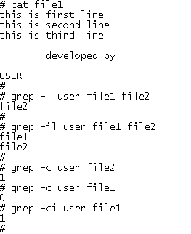
“ grep “ continues ….

Slide 64
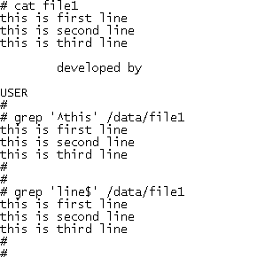
“ grep “ continues ..

Slide 65
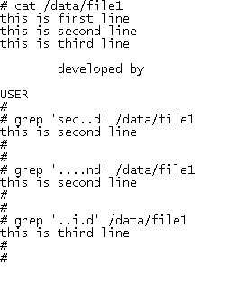
“ grep “ continues ..

Slide 66
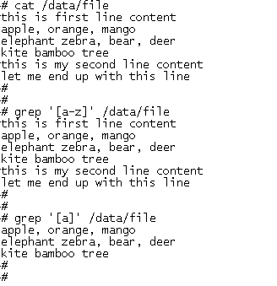
“ grep “ continues ….

Slide 67
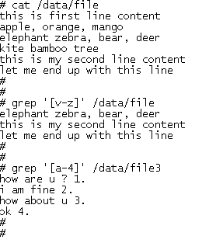
“ grep “ continues….

Slide 68
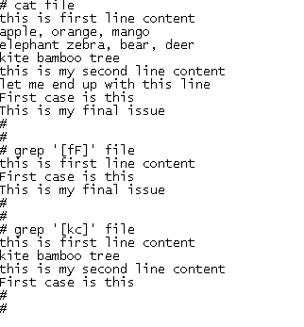
“ grep “ continues …

Slide 69
egrep
The egrep command searches the contents of one or more files for a pattern using extended regular expression metacharacters. Extended regular expression metacharacters include the regular expression metacharacters that the grep command uses, plus some additional metacharacters.

Slide 70
egrep
Metacharacter | Purpose | Sample | Result
+ | Matches one or more of the preceding characters | ’[a-z]+ark’ | Matches one or more lowercase letters followed by “ark” (for example, “airpark,” “bark,” “dark,” “landmark,” “shark,” “sparkle,” “trademark”)
? | Matches zero or one character | ‘patte[r?]’ | Matches lines Containing the literal character or metacharacter it follows
x | y | Matches either x or y | ’apple | orange’ | Matches for either expression

Slide 71
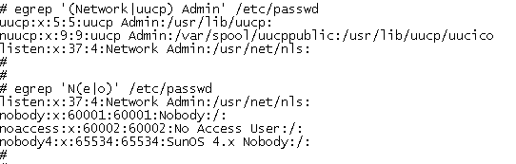
“ egrep Example :

Slide 72
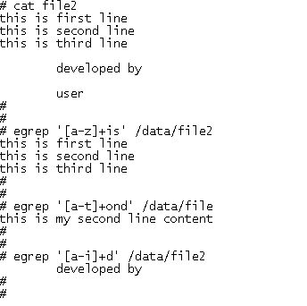
“ egrep “ continues…

Slide 73
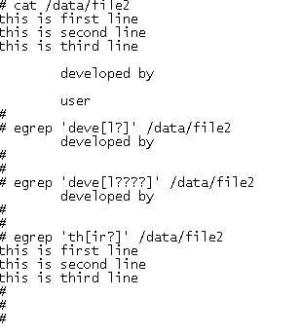
“ egrep continues …

Slide 74
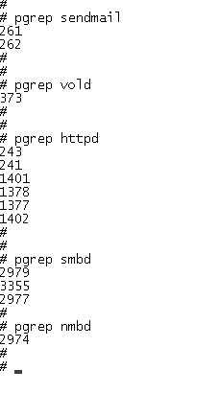
pgrep
The “ process grep “ command finds and displays the process ID along with It’s parent process ID.

Slide 75
ln command
Instead of copying you can also make links to existing files using ln command.
Some examples:
ln -s fileone filetwo will create a symbolic link and can exist across machines.
ln -n option will not overwrite existing files.
ln -f will force the link to occur.

Slide 76
Hard Links :
1. All Links have same inode number.
2.ls -l command shows all the links with the link column(Second) shows No. of links.
3. Links have actual file contents
4.Removing any link ,just reduces the link count , but doesn't affect other links.

Slide 77
Soft Links(Symbolic Links) :
1.Links have different inode numbers.
2. ls -l command shows all links with second column value 1 and the link points to original file.
3. Link has the path for original file and not the contents.
4.Removing soft link doesn't affect anything but removing original file ,the link becomes "dangling" link which points to nonexistant file.

Slide 78
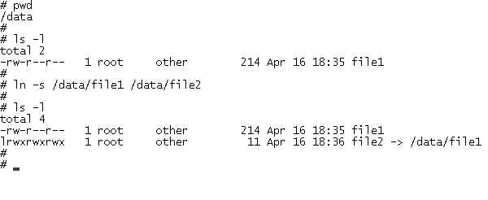
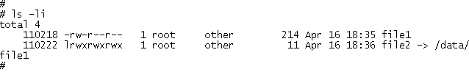
The following example shows the symbolic link.

Slide 79
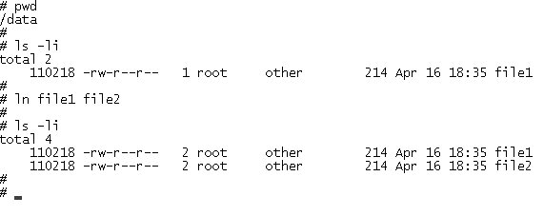
“ Hard Link “ creates link between source and destination.

Slide 80
sort command
sort command sort the lines of a file or files, in alphabetical order.
Options:
-c checks whether files are already sorted.
-n sorts in arithmetic order.
-ofile put output in a file.
-r reverse the order of sort.
-u identical lines in input file appear only one time in output.

Slide 81
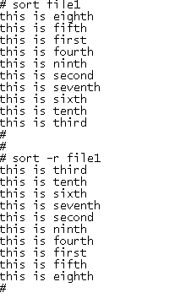
“ sort “ command displays file contents in ascending and
descending order.

Slide 82
cut command
cut command selects a list of columns or fields from one or more files.
Options:
-c list cut the column positions identified in list.
-f list will cut the fields identified in list.
-d selects based on the delimiter

Slide 83
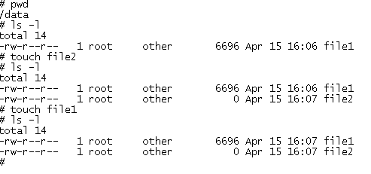
“ touch “ is the command which creates zero length files or
it puts time stamp on the file or files which are already exist.

Slide 84
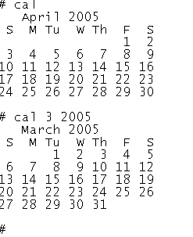
cal - It shows calendar

Slide 85
date command
date [options] [+format] [date]
Print the current date and time. A privileged user can change the system's date and time.
Date format :
mm dd hh mm yy . s

Slide 86
%a : Abbreviated weekday.
%b :Abbreviated month name.
%c :Country-specific date and time format.
%d :Day of month (01-31).
%h :Same as %b.
%j :Julian day of year (001-366).
%k :Hour in 24-hour format, without leading zeros (0-23).
%l :Hour in 12-hour format, without leading zeros (1-12).
%m:Month of year (01-12).
%n :Insert a new line.

Slide 87
%p :String to indicate a.m. or p.m.
%r :Time in %I:%M:%S %p (12-hour) format.
%s :Seconds since "the Epoch," which is 1970-01-01 00:00:00 UTC (a nonstandard extension).
%t :Insert a tab.
%w:Day of week (Sunday = 0).
%x :Country-specific date format based on locale.
%y :Last two digits of year (00-99).
%z :RFC 822-style numeric time zone.

Slide 88
%A :Full weekday.
%B :Full month name.
%D :Date in %m/%d/%y format.
%H :Hour in 24-hour format (00-23).
%I :Hour in 12-hour format (01-12).
%M :Minutes (00-59).
%S :Seconds (00-59).
%T :Time in %H:%M:%S format.
%U :Week number in year (00-53); start week on Sunday.
%V :Week number in year (01-52); start week on Monday.
%W :Week number in year (00-53); start week on Monday.
%Y :Four-digit year (e.g., 2006).
%Z :Time-zone name.

Slide 89
To find the location of a file
type <command>
  - show where the source of a command is: e.g.
  $ type ls
  ls is a tracked alias for /usr/bin/ls
whence <command>
  - show where the source of a command is: shell builtin command.
  Use option: -v for verbose mode
which <command>
  - show where the source of a command is held. Almost the same as type and whence

Slide 90
file command.
File command displays about the contents of a given file, whether it is a text (Ascii) or binary file.
To use it type
file filename.
Example:
11: ascii text
111: directory
111.sh: commands text
11.sh: commands text
123: directory

Slide 91
File Handling
Command
  compress (standard UNIX), gzip (GNU version – faster)
  uncompress, gunzip
Purpose
  Compresses text files to save disk space
Common options
  -v
    verbose, gives % compression ratio
$ ls -l MAG500
-rw-r--r-- 1 aem0 cineca 3249198 Jan 29 2002 MAG500
$ gzip –v MAG500
gzip -v MAG500
MAG500: 70.1% -- replaced with MAG500.gz
$
$ ls –l MAG500.gz
-rw-r--r-- 1 aem0 cineca 971325 Jan 29 2002 MAG500.gz

Slide 92
find command
find [pathnames] [conditions]
An extremely useful command for finding particular groups of files (numerous examples follow this description).
find descends the directory tree beginning at each pathname and locates files that meet the specified conditions. The default pathname is the current directory. The most useful conditions include -name and -type (for general use), -exec and -size (for advanced use), and -mtime and -user (for administrators).

Slide 93
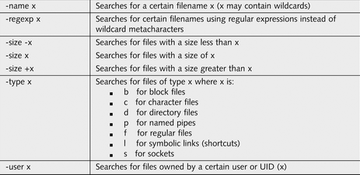
Find

Slide 94
tr command
tr [options] [string1 [string2] ]
Translate characters. Copy standard input to standard output, substituting characters from string1 to string2, or deleting characters in string1.
Examples
Change uppercase to lowercase in a file:
cat file | tr 'A-Z' 'a-z'

Slide 95
Search and Replace (tr)
tr 'x' 'y' < filename
  Replace every occurrence of 'x' with 'y'
tr –d 'x' < filename
  Deletes every occurrence of character 'x'
tr '\t' ' ' < filename
  Replaces every tab with a space
tr '[A-Z]' '[a-z]' < filename
  Replaces every upper case letter with a lowercase letter

Slide 96
who/w Command
who - list current users detail
who reports who is logged in at the present time
w command - displays full details about the logged in users like idle time, etc.
who am i - displays the current user (your) details like user name, terminal type, date/time, system name/ip address

Slide 97
Who command
who command displays information about the current status of system.
who options file
Who as default prints login names of users currently logged in.
Options
-a use all options.
-b Report information about last reboot.
-H print headings.
-u report terminal usage.

Slide 98
finger command
finger commands displays the information about the user(s).
$ finger inatrn01
Login name: inatrn01 In real life: Training Users
Directory: /u/inatrn01 Shell: /bin/ksh
On since May 15 16:29:06 on pts/15 from maajdt21bs.in.corp.inautix.com
No unread mail
No Plan.

Slide 99
id command
Purpose
  Tells you your username (!) and what group you belong to.
Example
$ id
uid=50083(aem0) gid=30(cineca)
Notes:
also whoami, w

Slide 100
stty command
stty command sets terminal input output options for the current terminal. without options stty reports terminal settings.
stty options modes < device >
Options
-a report all options.
-g report current settings.
erase keyname, will change your keyname to be backspace key.

Slide 101
du command
du [options] [directories]
Print disk usage (as the number of 1 KB blocks used by each named directory and its subdirectories; default is the current directory).
Options
-a, --all Print disk usage for all files, not just subdirectories.
-h, --human-readable Print sizes in human-readable format.
-s, --summarize Print only the grand total for each named directory.

Slide 102
df Command
Summarizes disk block and file usage
df is used to report the number of disk blocks and inodes used and free for each file program.
The output format and valid options are very specific to the OS and program version in use.
Syntax
  df [options] [resource]
Common Options
  - l local file systems only (SVR4)
  - k report in kilobytes (SVR4)

Slide 103
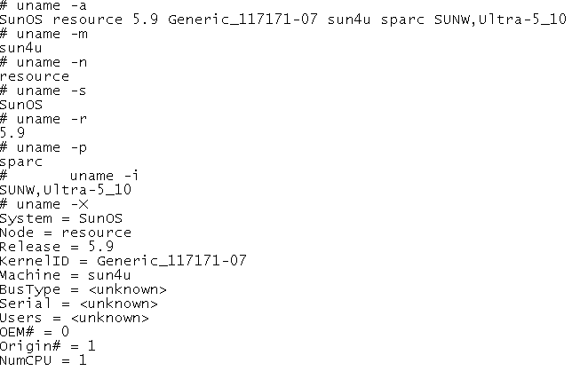
uname - It shows system identification information

Slide 104
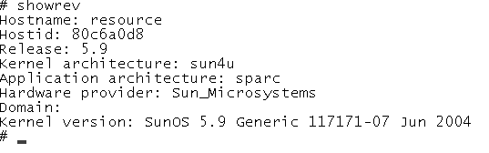
showrev - System information with Host ID

Slide 105
ps Command
ps - Show status of active processes
ps is used to repot on processes currently running on the system.
The output format and valid options are very specific to the OS and program version in use.

Slide 106
ps Command
Syntax
  ps [options]
Common Options
-e environment / everything
-l long format
-u user user oriented report
-f full listing

Slide 107
State of the process
State of the Process
  O process running
  S sleeping
  R Runnable (in Ready Q)
  Z (Zombie (process terminated parent not waiting)
  T process suspended by a job control signal or because it is being traced

Slide 108
kill Command
Kill – terminate a process
Kill sends a signal to a process, usually to terminate it.
Syntax
  Kill (-signal) process –id
Common Options
  -l - displays the available kill signals

Slide 109
Process
process is a program in execution
  process is created every time you run a command
  each process has a unique process id
  processes are removed from the system when the command finishes its execution
job is a unit of work
  consists of the commands specified in a single command line
  A single job may involve several processes, each consisting of an executable program
Notes:
C Shell Job Control
Copyright Department of Computer Science, Northern Illinois University, 2004

Slide 110
JOB CONTROL TERMINOLOGY
Foreground job:
  a job that has our immediate attention
  user has to wait for job to complete
Background job:
  a job that the user does not wait for
  it runs independently of user interaction
Unix shells allow users to:
  make jobs execute in the background,
  move jobs from foreground to background,
  determine their status, and terminate them

Slide 111
BACKGROUND JOBS
How do we decide which jobs to place in the background?
  jobs that are run non-interactively
  jobs that do not require user input
Examples:
  searching the file system for particular kinds of files
  solving complex equations
  compiling long programs
  backing up the file system

Slide 112
BACKGROUND JOBS
to execute command in the background, put
&
after it
Example:
  % date; cd projectc; cc gets.c –o gets &
  [1] 26432
  %
PID
Job number

Slide 113
MANAGING JOBS
display jobs
  command “jobs” lists your active jobs
  each job has job number
  job number with “%” is used to refer to job
send job to background
  bg
move job to foreground
  fg

Slide 114
Scheduling Jobs
Many system administration tasks need to be performed on a regular basis. Instead of the administrator having to execute these commands interactively at midnight, they can be scheduled to run daily using the cron scheduling command. Alternatively, if a job needs to be run only once at particular time, then you can use the at scheduler.

Slide 115
SCHEDULING UTILITIES
Crontab (= CRON Table)
  run a job based on a schedule
  job is executed on a periodic basis
at
  run a job some time in the future
batch
  run a job when system load is low
Notes:
C Shell Job Control
Copyright Department of Computer Science, Northern Illinois University, 2004

Slide 116
PERIODIC EXECUTION: CRONTAB
crontab is based on control file
crontab file has 6 columns:
  minute hour day month weekday command
meaning:
  minute 0-59
  hour 0-23
  day 1-31
  month 1-12
  weekday 1-7 (1=Mon,2=Tue, … ,7=Sun)
  command Any UNIX command
“*” means any value
Notes:
C Shell Job Control
Copyright Department of Computer Science, Northern Illinois University, 2004

Slide 117
EXAMPLE: CRONTAB FILE
0 8 * * 1 echo Happy Monday Morning
30 14 * * 1 echo Meeting at 3pm
0 17 * * 5 $HOME/bin/cleanup.sh
Notes:
C Shell Job Control
Copyright Department of Computer Science, Northern Illinois University, 2004

Slide 118
CRONTAB COMMAND
options:
-e to edit the control file
-l to list the control file
-r to remove the control file
for superuser
-u to edit another user’s control file

Slide 119
Each user on the system can have a crontab file, which allows them to schedule multiple events to occur at multiple times, on multiple dates.
The jobs are specified by files in the /var/spool/cron/cronjobs directory
configuration is managed by the files /etc/cron.d/cron.allow and /etc/cron.d/cron.deny.

Slide 120
ONE TIME EXECUTION: AT UTILITY
Use ‘at’ to run a command or list of commands at a later time
Must specify on the command the time and date on which your command to be executed
Do not have to be logged in when the commands are scheduled to run
Syntax:
  % at timeDate command

Slide 121
AT UTILITY
Can give as much of date as desired
If date/time has passed, command will run instantly
  In case system was down when it was supposed to run
Examples:
  % at 13:45 Wed
  % at 01:45 pm Sep 18
  % at 09:25 Sep 18 2010
  % at 09:25 Sep 18, 2010
  % at 11:00 pm tomorrow
  % at teatime # 4:00 pm

Slide 122
EXAMPLE: AT UTILITY
End input list with cntl-D = end-of-text
Remember command runs in batch
  No output on terminal
  May get email
  Or just look for side effects
% at 08:55 am tomorrow [Return]
at> enscript -Pcsl csci330.csh
at> <EOT>
commands will be executed using /bin/sh
job 1 at Thu Dec 4 08:55:00 2008

Slide 123
The jobs are specified by files in the /var/spool/cron/atjobs directory
configuration is managed by the files /etc/cron.d/at.allow and /etc/cron.d/at.deny.

Slide 124
at utilities
atq
lists user’s scheduled jobs
atrm
removes specified job from at queue
batch
schedules job to be performed is system load is low
CSCI 330 - The UNIX System

Slide 125
BATCH COMMAND
batch
schedules job to be performed when system load is low
same program as “at”
Syntax:
% batch command
on turing: low means load is less than 1.5

Slide 126
sleep – suspend execution for an interval
The sleep utility will suspend execution for at least the integral number of seconds specified by the time operand.
To execute a command after a certain amount of time:
(sleep 105; command)&
To execute a command every so often:
while true
do
command
sleep 37
done

Slide 127
System Resources and Printing
System Resources
  Commands to report or manage system resources
Command / Syntax
What it will do
date [options]
Report the current date and time
df [options] [resource]
Report the summary of disk blocks and inodes free and in use
du [options] [directory or file]
Report amount of disk space in use +
hostname / uname
Display or set (super-user only) the name of the current machine

Slide 128
System Resources and Printing
kill [options] (-SIGNAL) [pid#] [%job]
Send a single to the process with the process id number (pid#) or job control number (%n) The default signal is to kill the process
man [options] command
Show the manual (man) page for a command
passwd [options]
Set or change your password
ps [options]
Show status of active processes
script file
Saves everything that appears on the screen to file until exit is executed
stty [options]
Set or display terminal control options
bc
To do calculation in unix
which command
Reports the path to the command or the shell alias in use
who or w
Reports who is logged in and what processes are running

Slide 129
vi Editor
All commands in vi are preceded by the escape key.
Each time a different command is to entered, the escape key needs to be used.
Except where indicated, vi is case sensitive.

Slide 130
Cursor Movement Commands
(n)
Indicates a number, and is optional
(n) h
Left(n) space(s)
(n) j
Down(n) space(s)
(n) k
Up(n) space (s)
(n) l
Right (n) space (s)
(The arrow keys usually work also)
^F
Forward one screen
^B
Back one screen
^D
Down half screen

Slide 131
Cursor Movement Commands
^U
Up half screen
(^ indicates control key; case does not matter)
H
Beginning of top line of screen
M
Beginning of middle line of screen
L
Beginning of last line of screen
G
Beginning of last line of file
(n) G
Move to beginning of line (n)
0
(zero) beginning of line
$
End of line
(n)w
Forward (n) word (s)
(n)b
Back (n) word (s)
e
End of word

Slide 132
Cursor Movement Commands
Inserting Text
i
Insert text before the cursor
a
Append text after the cursor (does not overwrite other text)
I
Insert text at the beginning of the line
A
Append text to the end of the line
r
Replace the character under the cursor with next character typed
R
Overwrite characters until the end of the line (or until escape is pressed to change command)
o
(alpha o) open new line after the current line to type next
O
(alpha O) open new line before the current line to type next

Slide 133
Cursor Movement Commands
Deleting Text
dd
Deletes current line
(n) dd
Deletes (n) line(s)
(n) dw
Deletes (n) word(s)
D
Deletes from cursor to end of line
x
Deletes current character
(n) x
Deletes (n) character(s)
X
Deletes previous character

Slide 134
Cursor Movement Commands
Change Commands:
(n)cc
Changes (n) characters on line(s) until end of the line (or until escape is pressed)
cw
Changes characters of word until end of the word (or until escape is pressed)
(n)cw
Changes characters of the next (n) words
C$
Changes text to the end of the line
ct(x)
Changes text to the letter (x)
C
Changes remaining text on the current line (until stopped by escape key)

Slide 135
Cursor Movement Commands
~
Changes the case of the current character
J
Joins the current line and the next line
u
Undo the last command just done on this line
.
Repeats last change
s
Substitutes text for current character
S
Substitutes text for current line
:s
Substitutes new word(s) for old :<line nos effected> s/old/new/g

Slide 136
Cursor Movement Commands
&
Repeats last substitution (:s) command
(n)yy
Yanks (n) lines to buffer
Y(n)w
Yanks (n) words to buffer
p
Puts yanked or deleted text after cursor
P
Puts yanked or deleted text before cursor

Slide 137
Cursor Movement Commands
File Manipulation:
:w(file)
Writes changes to file (default is current file)
:wq
Writes changes to current file and quits edit session
:w!(file)
Overwrites file (default is current file)
:q
Quits edit session w/no changes made
:q!
Quits edit session and discards changes
:n
Edits next file in argument list

Slide 138
Cursor Movement Commands
:f(name)
Changes name of current file to (name)
:r (file)
Read contents of file into current edit at the current cursor position (insert a file)
:!(command)
Shell escape
:r!(command)
Inserts result of shell command at cursor position
ZZ
Write changes to current file and exit

Slide 139
Search for a text
/string - search down for string
?string - search up for string
N - repeat last search from present position
Eg 1.
/[a-z]as
will search for any lowercase letter followed by as. In this example, it would find was and last but not as or asked.
Eg 2.
/[^c]an
will search for any an preceded by any character other than a c. In our text it would find Milan but not scan or can.

Slide 140
Replace a text
:s/oldText/newText
This will replace the instance of 'oldText' with 'newText‘
:s/oldText/newText/g
This will replace all instances of 'oldText' with 'newText' in the current line
:%s/oldText/newText/g
This will replace all instances of 'oldText' with 'newText' throughout the file.

Slide 141
:.,$s/old/new/g
Substitutes old with new from the current cursor position to the end of the file
:^,.s/old/new/g
Substitutes old with new from the beginning of the file to the current cursor position
:& Repeats the last substitute (:s) command

Slide 142
Example
:n1,n2s/old/new/gc
n1
is the beginning line
n2
is the ending line number
s
means to substitute text matching the pattern (old) with text specified by (new)
g
optional. It indicates you want to substitute all occurrences on the indicated lines.
c
(confirm) is optional. It indicates you want to confirm each substitution before vi completes it.

Slide 143
Configuring your VI session
To configure the vi environment certain, options can be set with the line editor command :set during a vi editing session.
Alternatively, frequently used options can be set automatically when vi is invoked, by use of .exrc file.
This file can also contain macros to map keystrokes into functions using the map function.

Slide 144
Configuring your VI session
Within vi, these macros can be defined with the :map command.
The options available in vi include, but are not limited to, the following. Some options are not available on every Unix system.
  :set all - display all option settings
  :set ignorecase - ignore the case of character in a search
  :set list - display tabs and carriage returns
  : set nolist - turn off list option
  : set number - display line numbers

Slide 145
Configuring your VI session
:set nonumber - turn offline numbers
:set showmode - display indication that insert mode is on
:set noshowmode - turn off showmode option
:set wrapmargin = n -turn on word-wrap n spaces from the right margin
:set wrapmargin = 0 - turn off wrapmargin option
: set warn - display “No write since last change”
:set nowarn - turn off “write” warning

